Slide 1
Data Communication Terminologies

Slide 2
Introduction
Data -> information
Communication -> exchange information between two or more users.
Data Communication → Exchange of data between two or more users through the transmission media like twisted pair cable,coaxial cable,optical fibers,radio wave,satellite,microwave etc..

Slide 3
Transmission Media
Transmission media is a communication channel that carries the information from the sender to the receiver. Data is transmitted through the electromagnetic signals.

Slide 4
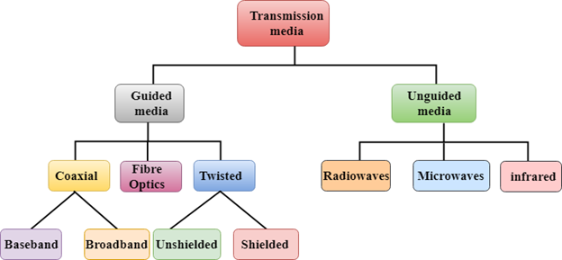
Classification of transmission media

Slide 5
Data Channel
Data Transfer Rate
Baud
Bits per second(bps)
Bandwidth
Data Channel:
Physical medium like cables over which information is exchanged is called channel. (Or)
Channel is the medium used to carry information or data from one point to another.

Slide 6
Data Transfer Rate
It determines the rate of speed at which the data is transferred from one point to another.
Its measurement unit is bits per second(bps),Bytes per second(Bps),or baud.In computer, data transfer is mainly measured in Bytes per second.

Slide 7
Contd….
Baud:
It is the unit of measurement for the information carrying capacity of communication channel.
The baud synonymous with bps(bits per second).
It is a another unit of measuring data transfer rates.
Bits per second(bps):
It refers to the speed at which the data transfer is measured.
Thousand bits per second is known as kbps ie.,kilo bits per second(Small k in kbps)
Thousand bytes per second is known as Kbps ie.,Kilo bytes per second( Capital K in Kbps)

Slide 8
Contd..
1Bps=1 Byte per second=8 bits per second
1 Kbps=1 Kilo bit per second=1024 bits per second
1Mbps=1 Megabit per second=1024 Kbps
1Gbps=1 Gigabit per second=1024 Mbps
“kilo-”,“mega-”,”giga-”,”tera-”,
“K” ,”M” ,”G”,”T” --→ it denotes powers of 1000
For eg: 64kbps= 64000 bps

Slide 9
Bandwidth
Bandwidth is the capacity of a wired or wireless network connection link to transmit the maximum amount of data from one point to another over a computer network or internet connection in a given amount of time → usually in one second.
1.For eg: it takes more bandwidth to download a photograph in one second.
2.Large sound files,computer programs and animated videos requires still more bandwidth for acceptable system performance.

Slide 10
Contd…
High bandwidth channels are called broadband channels.
Low bandwidth channels are called narrowband channels.
Frequency is measured in cycles per second(hertz)
Voice signal has the bandwidth of approximately three kilohertz(3 KHz)
An analog television (TV) broadcast video signal has the bandwidth of six megahertz(6 MHz)- 2000 times as wider as the voice signal.

Slide 11
Contd…
Kilohertz(KHz)-Thousand cycles per second
Megahertz(MHz)-Thousand KHz
Gigahertz(GHz)-Thousand MHz
Terahertz(THz)-Thousand GHz

